Slide 1
Industrial Pharmacy II Assist. Lect. Amenah M. M.

Slide 2
Microencapsulation

Slide 3
Microencapsulation Microencapsulation is the process by which individual particles or droplets of solid or liquid material (the core) are surrounded or coated with a continuous film of polymeric material (the shell or coating material) to produce capsules in the micrometer to millimeter range, known as microcapsules.

Slide 4
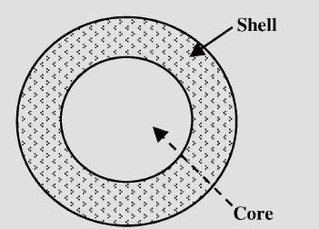
Microcapsule with core and coat

Slide 5
Microencapsulation is differentiated from macrocoating techniques in that the former involves the coating of particles ranging dimensionally from several tenths of a micron to 5000 microns in size.

Slide 6
1. This technique can be used for converting liquid drugs in a free flowing powder. 2. The drugs, which are sensitive to oxygen, moisture or light, can be stabilized by microencapsulation. 3. Incompatibility among the drugs can be prevented by microencapsulation.
The applications of microencapsulation include:

Slide 7
4. Vaporization of many volatile drugs e.g. methyl salicylate and peppermint oil can be prevented by microencapsulation. 5. Many drugs have been microencapsulated to reduce toxicity and GI irritation including ferrous sulphate and KCl. 6. Alteration in site of absorption can also be achieved by microencapsulation.

Slide 8
7. Toxic chemicals such as insecticides may be microencapsulated to reduce the possibility of sensitization of factorial person. 8. Microencapsulated vitamin A palmitate had enhanced stability. 9. Controlling the release characteristics or availability of coated materials.

Slide 9
11. Because of the smallness of the particles, drug moieties can be widely distributed throughout the gastrointestinal tract, thus potentially improving drug sorption.
10. Masking the taste or odor of the core.

Slide 10
Core Material:
The material to be coated
It may be liquid or solid
Liquid core may be dissolved or dispersed material
Composition of coating material:
Drug or active constituent
Additive like diluents
Stabilizers
Release rate enhancers

Slide 11
Coating Material: Inert substance which coats on core with desired thickness - Compatible with the core material. - Stabilization of core material. - Inert toward active ingredients. - Controlled release under specific conditions. - The coating can be flexible, brittle, hard, thin etc. - Abundantly and cheaply available.

Slide 12
Typical coating properties such as cohesiveness, permeability, moisture sorption, solubility, stability, and clarity must be considered in the selection of the proper microcapsule coating material.

Slide 13
Examples of Coating materials: 1. Water soluble resins: Gelatin, Gum Arabic, Starch, Polyvinylpyrrolidone, Carboxymethylcellulose, Hydroxyethylcellulose, Methylcellulose, Arabinogalactan, Polyvinyl alcohol, Polyacrylic acid.

Slide 14
2.Water insoluble resins: Ethylcellulose, Polyethylene, Polymethacrylate, Polyamide (Nylon), Poly (Ethylene Vinyl acetate), cellulose nitrate, Silicones, Poly lactideco glycolide. 3.Waxes and lipids: Paraffin, Carnauba, Spermaceti, Beeswax, Stearic acid, Stearyl alcohol, Glyceryl stearates. 4.Enteric resins: Shellac, Cellulose acetate phthalate, Zein.

Slide 15
Equipment and Processing

Slide 16
Microencapsulation Methods 1. Air suspension. 2. Coacervation-phase separation. 3. Spray drying and spray congealing. 4. Solvent evaporation techniques. 5. Pan coating. 6. Polymerization techniques. 7. Vacuum deposition.

Slide 17
Air-suspension coating
Microencapsulation by air suspension technique consist of the dispersing of solid, particulate core materials in a supporting air stream and the spray coating on the air suspended particles. Within the coating chamber, particles are suspended on an upward moving air stream.

Slide 18
The design of the chamber and its operating parameters effect a recirculating flow of the particles through the coating zone portion of the chamber, where a coating material, usually a polymer solution, is spray-applied to the moving particles.

Slide 19
During each pass through the coating zone, the core material receives an increment of coating material. The cyclic process is repeated, perhaps several hundred times during processing, depending on the purpose of microencapsulation, the coating thickness desired, or whether the core material particles are thoroughly encapsulated.

Slide 20
The supporting air stream also serves to dry the product while it is being encapsulated. Drying rates are directly related to the volume temperature of the supporting air stream.

Slide 21
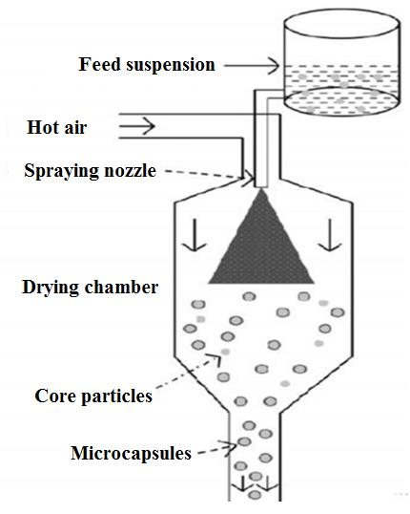
Air suspension method for microencapsulation

Slide 22
Processing variables for efficient and effective encapsulation by air suspension techniques; 1. Density, surface area, melting point, solubility, friability, volatility, crystallinity, and flowability of the core material. 2. Coating material concentration (or melting point if not a solution). 3. Coating material application rate.

Slide 23
4. Volume of air required to support and fluidize the core material. 5. Amount of coating material required. 6. Inlet and outlet operating temperatures.

Slide 24
Coacervation-Phase Separation
The processes consists of three steps carried out under continuous agitation:
1. Formation of three immiscible chemical phases.
2. Deposition of the coating.
3. Rigidization of the coating.

Slide 25
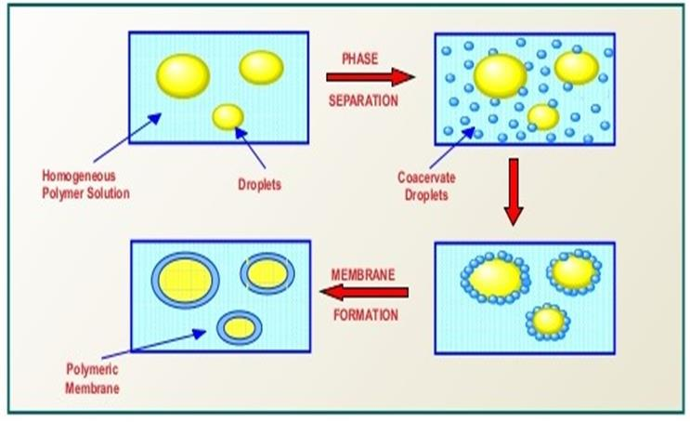
Coacervation process: (a) Core material dispersion in solution of shell polymer; (b) Separation of coacervate from solution; (c) Coating of core material by micro droplets of coacervate; (d) Coalescence of coacervate to form continuous shell around core particles.

Slide 26
Spray Drying and Spray Congealing
Spray-drying and spray-congealing processes are similar in that both involve dispersing the core material in a liquefied coating substance and spraying or introducing the core-coating mixture into some environmental condition, whereby relatively rapid solidification (and formation) of the coating is effected.

Slide 27
The principal difference between the two methods is the means by which coating solidification is accomplished. Coating solidification in the case of spray drying is effected by rapid evaporation of a solvent in which the coating material is dissolved.

Slide 28
Coating solidification in spray congealing methods is accomplished by thermally congealing a molten coating material or by solidifying a dissolved coating by introducing the coating-core material mixture into a nonsolvent. Removal of the nonsolvent or solvent from the coated product is then accomplished by sorption, extraction, or evaporation techniques.

Slide 29
Process control variables
Feed material properties such as viscosity, uniformity.
Concentration of core and coating material.
Feed rate.
Method of atomization.
The drying rate, which is normally controlled by the inlet and outlet temperatures.
The air stream solvent concentration.

Slide 30
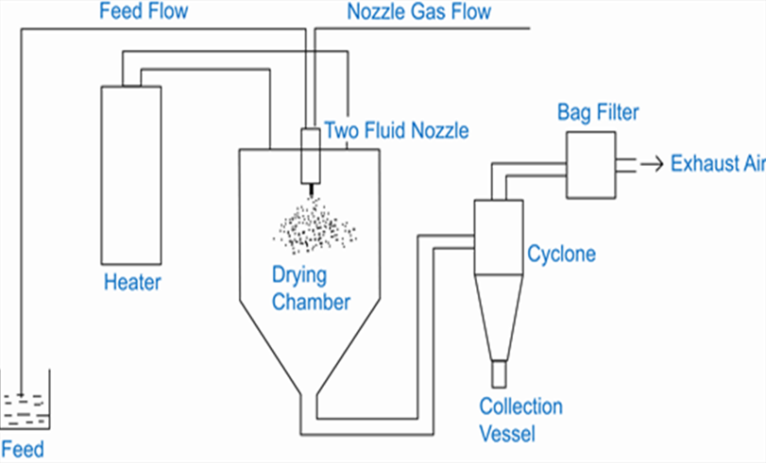
Spray Dryer

Slide 31
The process produces microcapsules approaching a spherical structure in the size range of 5 to 600 microns. Characteristically, spray drying yields products of low bulk density, owing to the porous nature of the coated particles.

Slide 32
Microencapsulation by spray drying and spray congealing is quite similar, they can be accomplished with same spray drying equipment and the general process variables and conditions are similar, except that in spray congealing the core material is dispersed in a coating material melt rather than a coating solution.

Slide 33
Coating solidification is accomplished by spraying the hot mixture into a cool air stream. Waxes, fatty acids and alcohols, polymers and sugars, which are solids at room temperature but meltable at reasonable temperatures.

Slide 34
Solvent Evaporation
The processes are carried out in a liquid manufacturing vehicle.
The microcapsule coating is dissolved in a volatile solvent, which is immiscible with the liquid manufacturing vehicle phase.

Slide 35
A core material to be microencapsulated is dissolved or dispersed in the coating polymer solution. With agitation, the core coating material mixture is dispersed in the liquid manufacturing vehicle phase to obtain the appropriate size microcapsule.

Slide 36
The mixture is then heated to evaporate the solvent for the polymer. In the case in which the core material is dispersed in the polymer solution, polymer shrinks around the core. In the case in which the core material is dissolved in the coating polymer solution, a matrix-type microcapsule is formed.

Slide 37
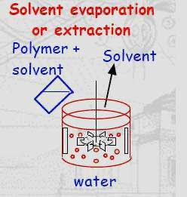

Slide 38
Once all the solvent for the polymer is evaporated, the liquid vehicle temperature is reduced to ambient temperature with continued agitation. At this stage, the microcapsules can be used in suspension form, coated on to substrates or isolated as powders.

Slide 39
Process variables would include:
1. Methods of forming dispersions.
2. Evaporation rate of the solvent for the coating polymer.
3. Temperature cycles.
4. Agitation rates.

Slide 40
Pan Coating
The particles are tumbled in a pan while the coating material is applied slowly, solid particles greater than 600 microns in size are generally considered essential for effective coating, and the process has been extensively employed for the preparation of controlled - release beads.

Slide 41
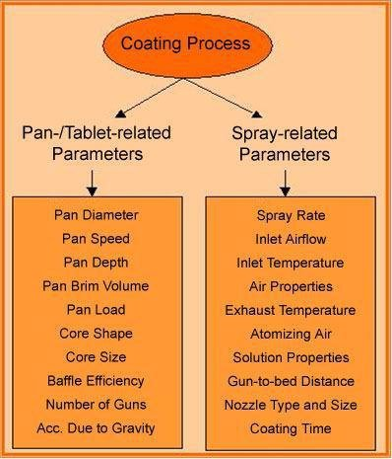

Slide 42
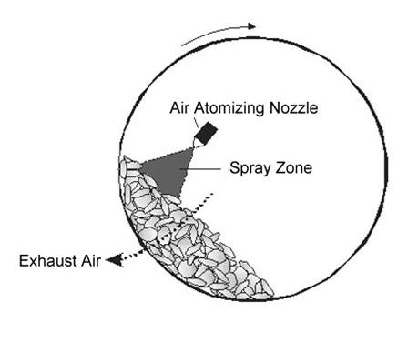
Pan Coating

Slide 43
Polymerization
The methods involve the reaction of monomeric units located at the interface existing between a core material substance and a continuous phase in which the core material is dispersed.

Slide 44
The continuous or core material supporting phase is usually a liquid or gas, and therefore the polymerization reaction occurs at a liquid-liquid, liquid-gas, solid-liquid, or solid-gas interface.

Slide 45
Thank You

